Slide 1

Chapter 6
Bandwidth Utilization:
Multiplexing and Spreading
6.<number>
Copyright © The McGraw-Hill Companies, Inc. Permission required for reproduction or display.

Slide 2

Note
Bandwidth utilization is the wise use of
available bandwidth to achieve
specific goals.
Efficiency can be achieved by multiplexing; privacy and anti-jamming can be achieved by spreading.
6.<number>

Slide 3
6-1 MULTIPLEXING
Whenever the bandwidth of a medium linking two devices is greater than the bandwidth needs of the devices, the link can be shared. Multiplexing is the set of techniques that allows the simultaneous transmission of multiple signals across a single data link. As data and telecommunications use increases, so does traffic.
Topics discussed in this section:
Frequency-Division Multiplexing
Wavelength-Division Multiplexing
Synchronous Time-Division Multiplexing
Statistical Time-Division Multiplexing
6.<number>

Slide 4

Figure 6.1 Dividing a link into channels
6.<number>

Slide 5

Figure 6.2 Categories of multiplexing
6.<number>

Slide 6

Figure 6.3 Frequency-division multiplexing
6.<number>

Slide 7
Note
FDM is an analog multiplexing technique that combines analog signals.
6.<number>

Slide 8

Figure 6.4 FDM process
6.<number>

Slide 9

Figure 6.5 FDM demultiplexing example
6.<number>

Slide 10
Example 6.1
Assume that a voice channel occupies a bandwidth of 4 kHz. We need to combine three voice channels into a link with a bandwidth of 12 kHz, from 20 to 32 kHz. Show the configuration, using the frequency domain. Assume there are no guard bands.
Solution
We shift (modulate) each of the three voice channels to a different bandwidth, as shown in Figure 6.6. We use the 20- to 24-kHz bandwidth for the first channel, the 24- to 28-kHz bandwidth for the second channel, and the 28- to 32-kHz bandwidth for the third one. Then we combine them as shown in Figure 6.6.
6.<number>

Slide 11

Figure 6.6 Example 6.1
6.<number>

Slide 12
Example 2
Five channels, each with a 100-KHz bandwidth, are to be multiplexed together. What is the minimum bandwidth of the link if there is a need for a guard band of 10 KHz between the channels to prevent interference?
Solution
For five channels, we need at least four guard bands. This means that the required bandwidth is at least
5 x 100 + 4 x 10 = 540 KHz,
as shown in next slide Figure

Slide 13
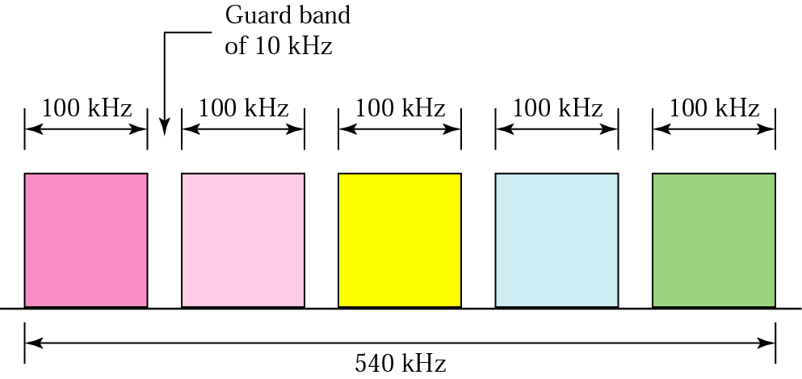
Solution of Example 2

Slide 14

Figure 6.9 Analog hierarchy
6.<number>

Slide 15

Figure 6.10 Wavelength-division multiplexing
6.<number>

Slide 16
Note
WDM is an analog multiplexing technique to combine optical signals.
6.<number>

Slide 17

Figure 6.11 Prisms in wavelength-division multiplexing and demultiplexing
6.<number>

Slide 18

Figure 6.12 TDM
6.<number>

Slide 19
Note
TDM is a digital multiplexing technique for combining several low-rate
channels into one high-rate one.
6.<number>

Slide 20

Figure 6.13 Synchronous time-division multiplexing
6.<number>

Slide 21
Note
In synchronous TDM, the data rate
of the link is n times faster, and the unit duration is n times shorter.
6.<number>

Slide 22
Example
Four 1-Kbps connections are multiplexed together. A unit is 1 bit. Find (1) the duration of 1 bit before multiplexing, (2) the transmission rate of the link, (3) the duration of a time slot, and (4) the duration of a frame?
Solution
We can answer the questions as follows:
1. The duration of 1 bit is 1/1 Kbps, or 0.001 s (1 ms).
2. The rate of the link is 4 Kbps.
3. The duration of each time slot 1/4 ms or 250 ms.
4. The duration of a frame 1 ms.

Slide 23

Figure 6.15 Interleaving
6.<number>

Slide 24

Figure 6.18 Empty slots
6.<number>

Slide 25

Figure 6.26 TDM slot comparison
6.<number>

Slide 26
Example
Four channels are multiplexed using TDM. If each channel sends 100 bytes/s and we multiplex 1 byte per channel, show the frame traveling on the link, the size of the frame, the duration of a frame, the frame rate, and the bit rate for the link.
Solution
The multiplexer is shown in next slide Figure

Slide 27
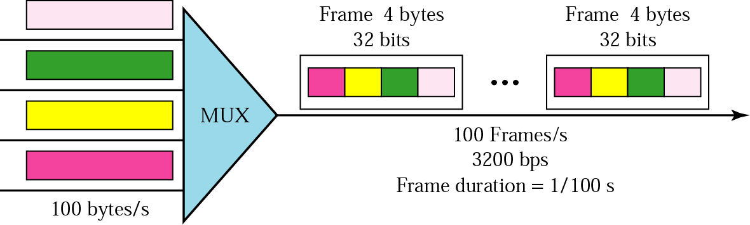
Solution of Example

Slide 28
Example
A multiplexer combines four 100-Kbps channels using a time slot of 2 bits. Show the output with four arbitrary inputs. What is the frame rate? What is the frame duration? What is the bit rate? What is the bit duration?
Solution
Figure on the next slide shows the output for four arbitrary inputs.

Slide 29
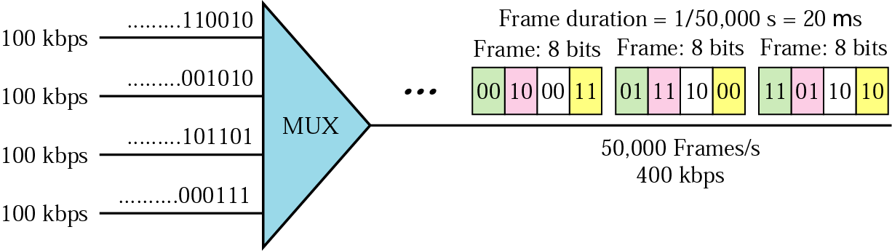
Solution of Example

Slide 30
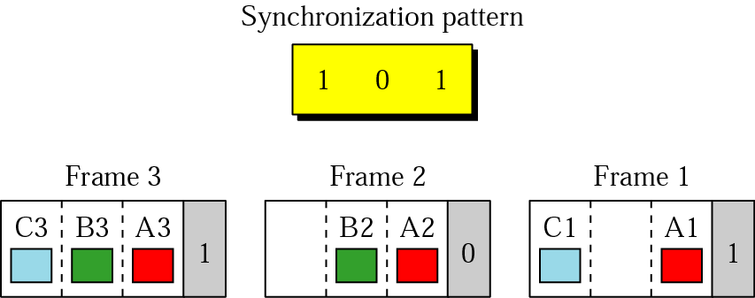
Framing Bits and Bit Padding
When speed of two devices is different and it is not integer multiples of each other, they can be made to behave as if they were , by a technique called bit padding.

Slide 31
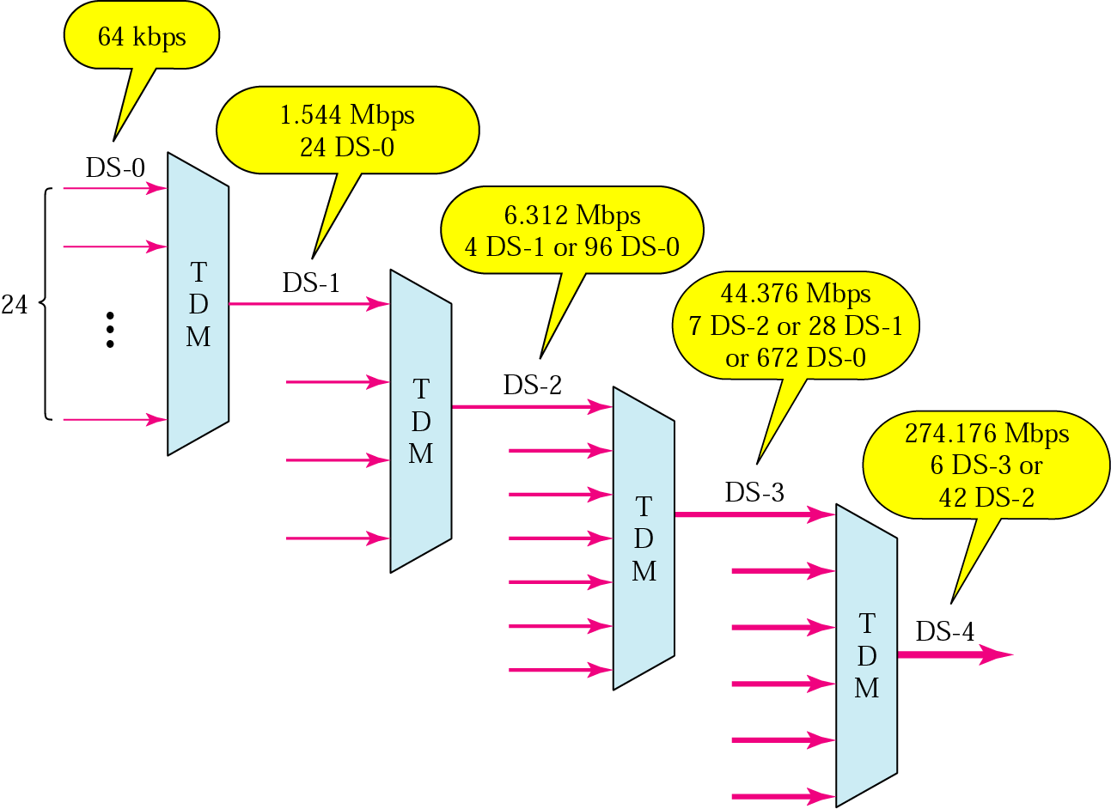
Digital Signal (DS) Service

Slide 32
DS and T lines rates
Service | Line | Rate (Mbps) | Voice Channels
DS-1 | T-1 | 1.544 | 24
DS-2 | T-2 | 6.312 | 96
DS-3 | T-3 | 44.736 | 672
DS-4 | T-4 | 274.176 | 4032

Slide 33
E line rates
E Line | Rate (Mbps) | Voice Channels
E-1 | 2.048 | 30
E-2 | 8.448 | 120
E-3 | 34.368 | 480
E-4 | 139.264 | 1920

Slide 34
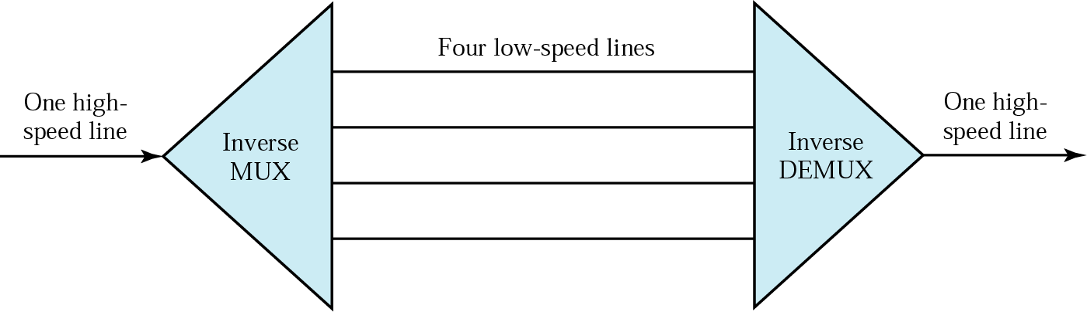
Multiplexing & inverse Multiplexing

Slide 35
6-1 SPREAD SPECTRUM
In spread spectrum (SS), we combine signals from different sources to fit into a larger bandwidth, but our goals are to prevent eavesdropping and jamming. To achieve these goals, spread spectrum techniques add redundancy.
Topics discussed in this section:
Frequency Hopping Spread Spectrum (FHSS)
Direct Sequence Spread Spectrum Synchronous (DSSS)
6.<number>

Slide 36

Figure 6.27 Spread spectrum
6.<number>

Slide 37

Frequency selection in FHSS

Slide 38

Bandwidth sharing

Slide 39


Direct Sequence Spread Spectrum

